Slide 1
Working with Big Data
Shahriar’s Analytical Academy

Slide 2
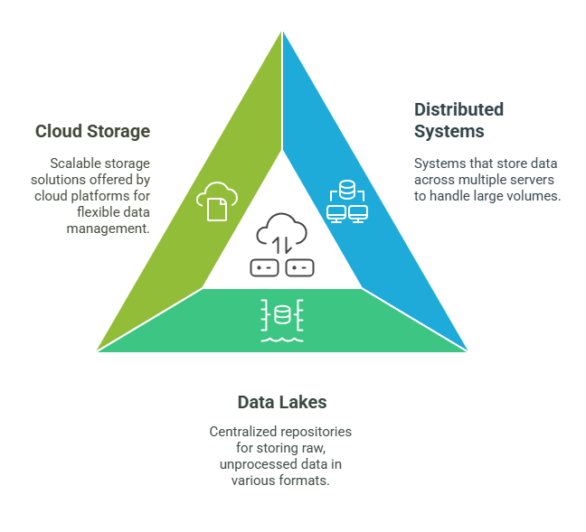
Data Collection
and Storage
Notes:
Distributed Systems: Big data is often too large to be stored on a single computer, so it is spread across many computers, which are part of a network. This way, no single computer becomes overloaded. A tool like Hadoop Distributed File System (HDFS) helps in storing large amounts of data across these multiple computers in a way that is efficient and accessible.
Data Lakes: Imagine a huge warehouse that holds all types of data in their original form, without changing them. This is what a data lake does. It stores data in a raw state, allowing it to be collected from many different sources. Whether the data is structured, like tables in a database, or unstructured, like social media posts, data lakes can hold it all in one place for future processing.
Cloud Storage: With the rise of cloud services, platforms like Amazon Web Services (AWS), Google Cloud, and Microsoft Azure offer scalable storage for big data. This means businesses can store huge amounts of data without having to invest in expensive hardware. They pay only for what they use, and can scale up or down as needed.

Slide 3
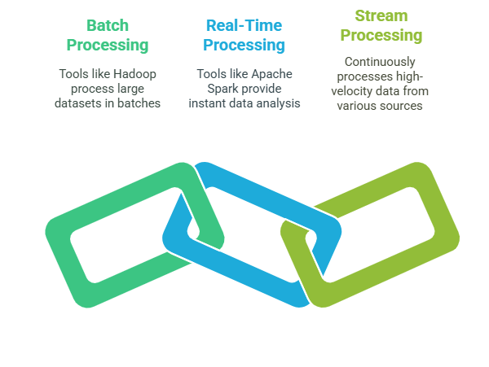
Data
Processing
Notes:
Batch Processing: Sometimes, large amounts of data don’t need to be analyzed immediately. Batch processing involves dividing this large data into smaller chunks and processing them in groups, or batches. Hadoop is an example of a tool that processes data this way. It's useful for datasets that are too big to be processed all at once and don't require real-time insights.
Real-Time Processing: In some cases, data needs to be processed immediately. For example, when detecting fraud or monitoring a system, real-time processing tools like Apache Spark or Apache Flink analyze data as it comes in. This allows businesses to make quick decisions based on the most up-to-date information.
Stream Processing: Stream processing focuses on continuously processing data that flows in from sources like sensors or social media. This type of data is generated in real-time and needs to be analyzed instantly. Stream processing tools help handle this high-speed data, making it ideal for things like live event monitoring or Internet of Things (IoT) analytics.

Slide 4
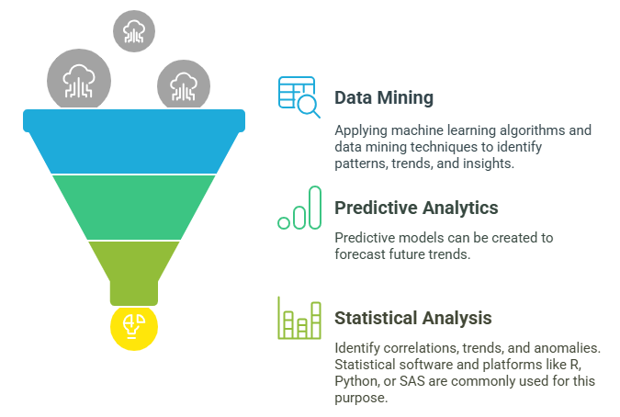
Data
Analysis
Notes:
Data Mining and Machine Learning: To make sense of big data, machine learning algorithms and data mining techniques are often used. These methods help in discovering patterns, predicting trends, or grouping data into useful categories. For instance, businesses might use these techniques to predict customer behavior or identify fraud.
Predictive Analytics: Predictive analytics involves using past data to forecast future trends. By applying statistical models and machine learning, businesses can make educated guesses about what might happen in the future, like predicting market trends or consumer preferences.
Statistical Analysis: Analyzing data using statistical methods helps uncover trends, correlations, or anomalies. Tools like R, Python, or SAS are commonly used to perform statistical analysis. This method helps in understanding patterns and making data-driven decisions.

Slide 5
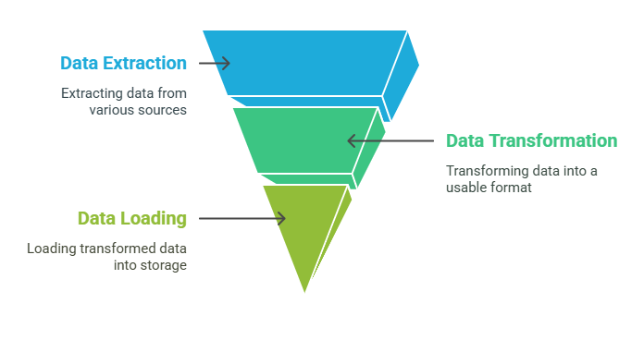
Data
Integration
Notes:
ETL (Extract, Transform, Load): The ETL process involves three main steps: extracting data from different sources, transforming it into a format that is easy to analyze, and then loading it into a data storage system. This is especially helpful when integrating data from multiple sources, making it ready for further analysis.

Slide 6
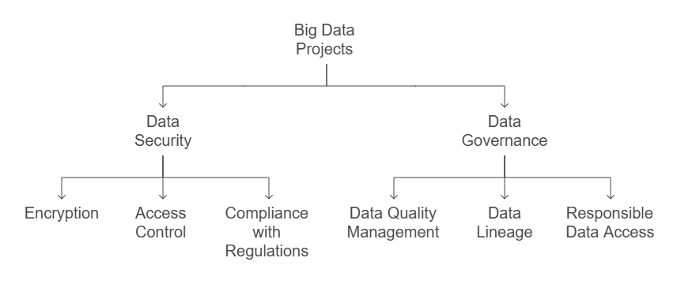
Data Security & Governance
Notes:
Data Security: Big data often contains sensitive information, such as customer details or financial records, making it important to protect it. This involves encrypting the data, controlling who can access it, and following data privacy laws like the GDPR to ensure personal information is kept safe.
Data Governance: Data governance is all about setting rules and guidelines for managing data. This includes ensuring the data is accurate, reliable, and used properly. It also involves tracking where data comes from and who is allowed to access it. Proper governance ensures that data is used responsibly and remains high-quality.

Slide 7
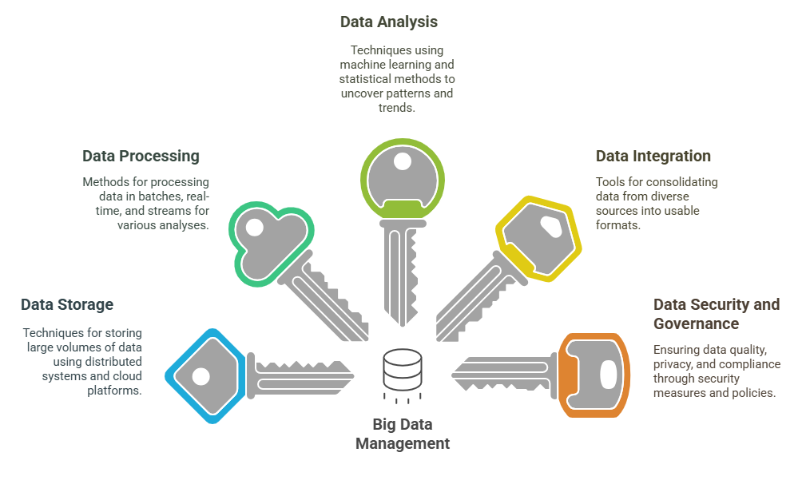
5 Key Learning Points of this Lesson
Notes:
Data Storage Techniques: Big data is stored using distributed systems like Hadoop Distributed File System (HDFS), data lakes (for raw data in various formats), and cloud storage platforms like AWS, Google Cloud, and Azure, which offer scalable and flexible solutions.
Data Processing Methods: Data processing in big data is done through batch processing (Hadoop), real-time processing (Apache Spark), and stream processing (for continuous data from sources like sensors or social media), allowing for different types of analysis based on urgency and data flow.
Data Analysis Techniques: Big data analysis involves using machine learning, data mining, predictive analytics, and statistical methods to uncover patterns, forecast trends, and make data-driven decisions.
Data Integration Tools: ETL (Extract, Transform, Load) tools are essential for integrating data from various sources into databases or data warehouses for analysis, enabling the consolidation of diverse data types into a usable format.
Data Security and Governance: Ensuring data security through encryption and access control, along with implementing data governance policies, is vital for maintaining data quality, privacy, and compliance with regulations such as GDPR.

Slide 8
Thank You!
Shahriar’s Analytical Academy

